Slide 1
Supervised learning key phases
Machine Learning with Python

Slide 2
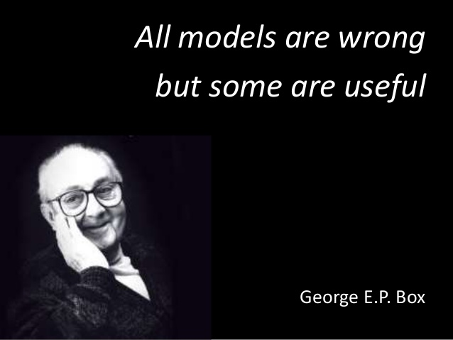
Key terminology
Model – a set of patterns learned from historical data.
Algorithm – a specific ML process used to train a model.
Multiple models can be created from the same algorithm using different hyperparameters

Slide 3
Key terminology
Features – Variables (columns) in the dataset used to train the model.
Target variable – A specific variable you’re trying to predict.
Observations – Data points (rows) in the dataset
Training data – the dataset from which the algorithm learns the model.
Test data – a new dataset for reliably evaluating model performance.

Slide 4
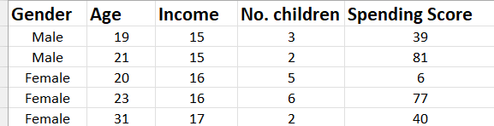
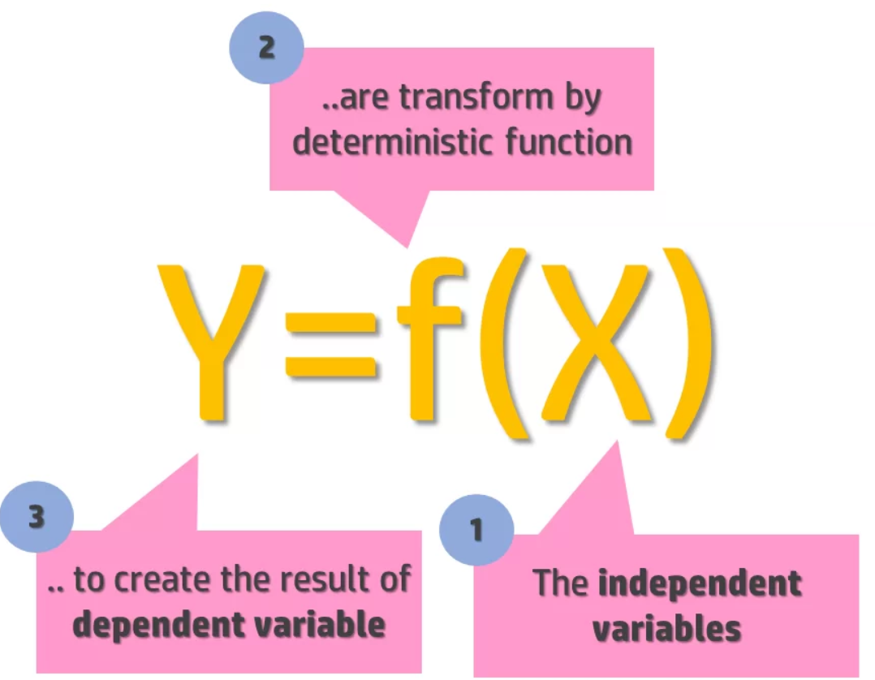
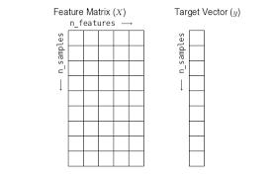
Input / independent / feature variables
Output / dependent / target variable (label)
Observations /
Samples / Datapoints

Slide 5
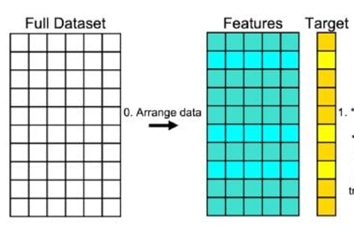
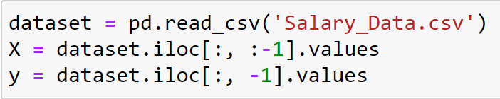

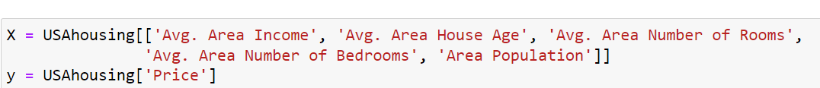
Arrange dataset into feature matrix and target variable

Slide 6
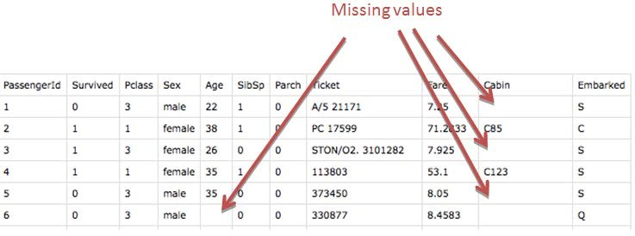
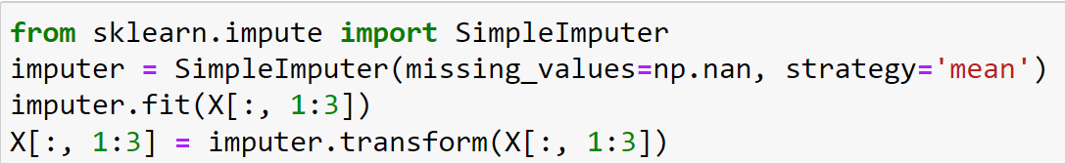
Handling missing values

Slide 7
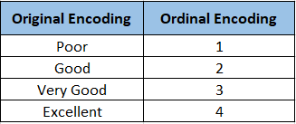
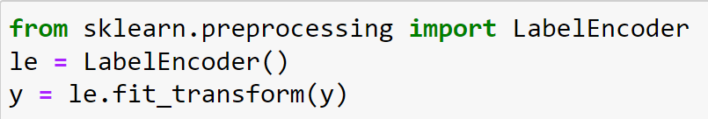
Ordinal / label encoding

Slide 8
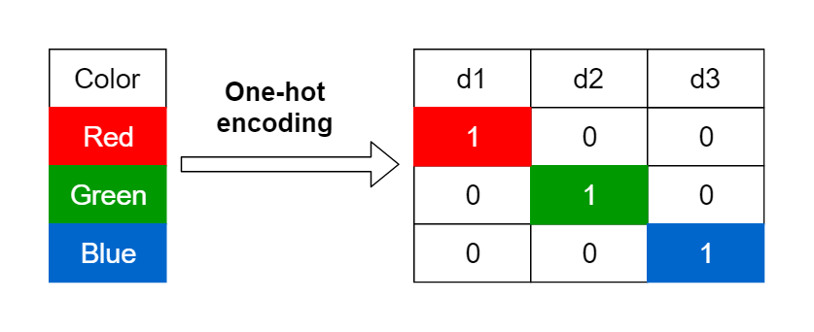
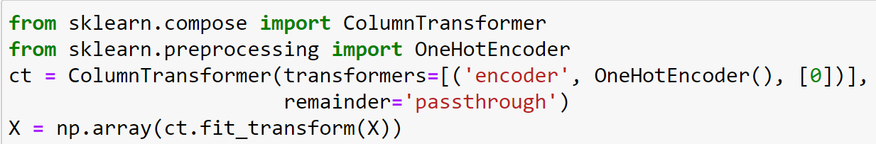
One hot encoding

Slide 9
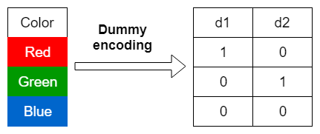
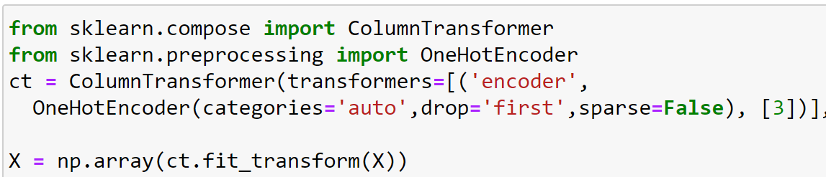
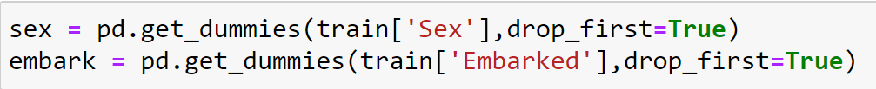
Dummy encoding

Slide 10
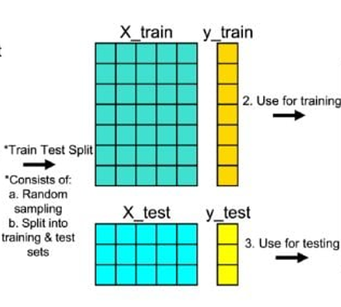
Split into training and test dataset

Slide 11
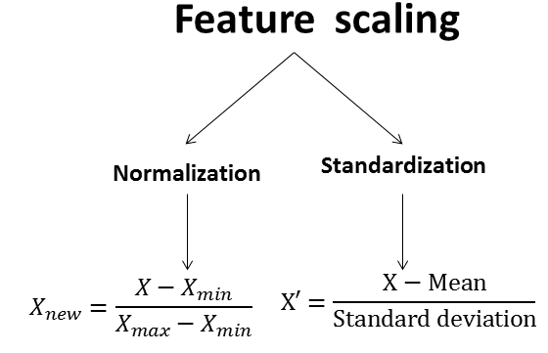
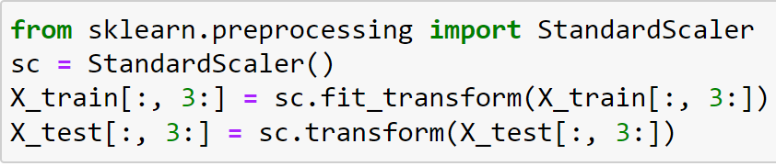
Feature scaling

Slide 12
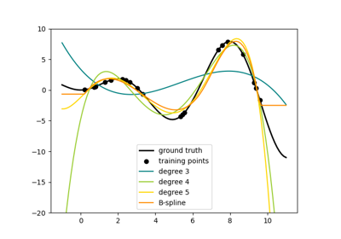
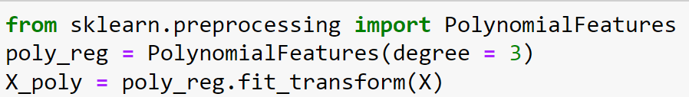
Generating polynomial features

Slide 13
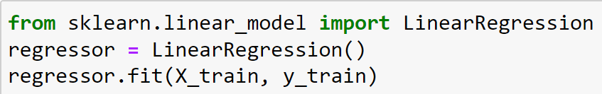
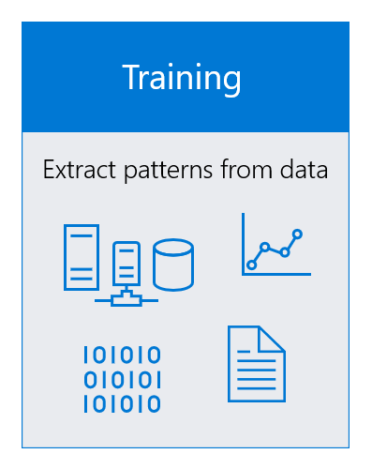
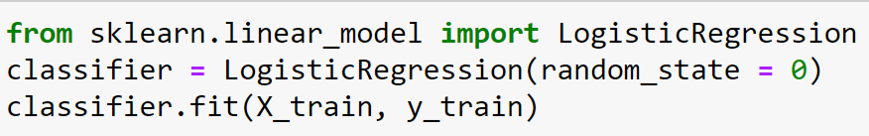
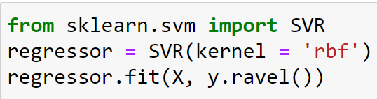
Training model using training set

Slide 14
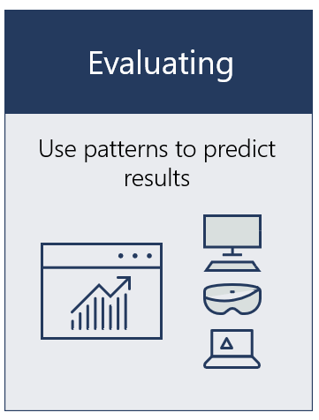
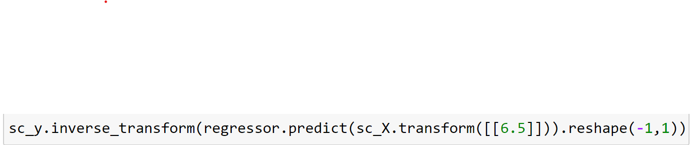
Predicting results on single value or entire test set

Slide 15
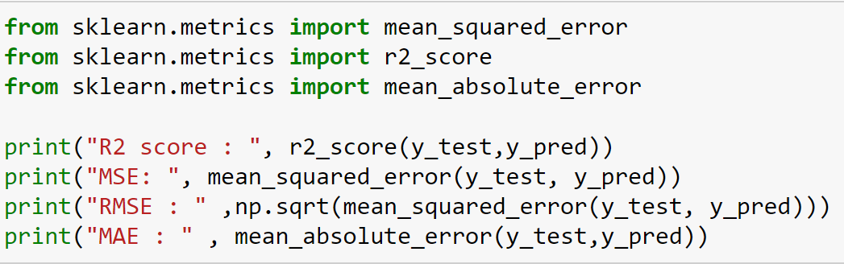
Evaluation criteria (Regression)

Slide 16
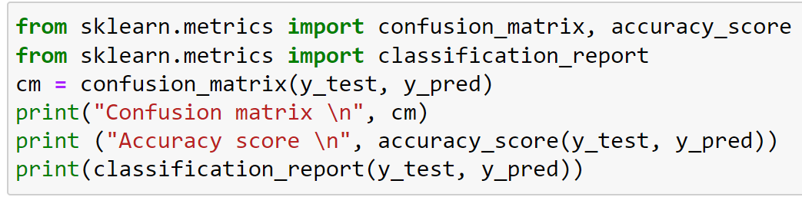
Evaluation criteria (Classification)

